Slide 1
Conceptual Dynamics
Part II: Kinematics of Particles
Chapter 3
Kinematics of Particles
Plane Curvilinear Motion
Polar coordinates

Slide 2
Polar Coordinate System

Slide 3
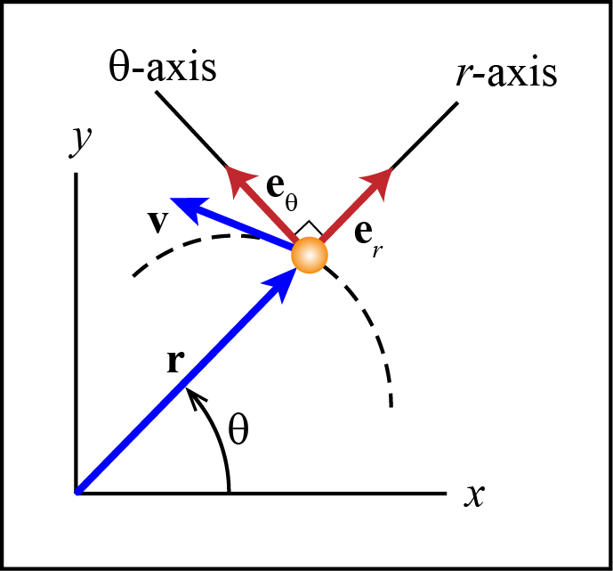
Polar Coordinate System
The Polar Coordinate System is defined by the coordinates r and θ.
The r and θ axes are attached to and move with the particle.

Slide 4
Radial coordinate & the r-axis
Radial Coordinate (r) The distance from the origin of the x-y coordinate system to the particle.

Slide 5
Radial coordinate & the r-axis
r – axis: Parallel to r and points away from the origin.

Slide 6
Transverse Coor. & the θ-axis
Transverse Coordinate (θ) The angle between the positive x-axis and r.

Slide 7
Transverse Coor. & the θ-axis
θ – axis: Perpendicular to the r – axis and is positive in the direction of increasing θ.

Slide 8
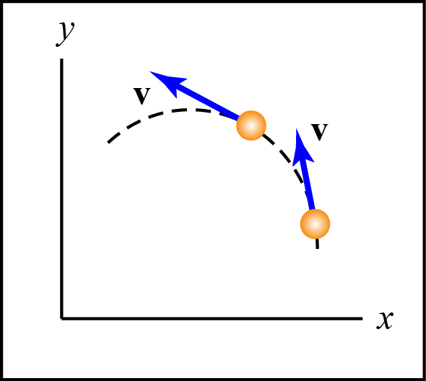
Example 3.4-1
Draw the r-θ axes, and the radial and transverse coordinates for both positions of the particle shown.

Slide 9
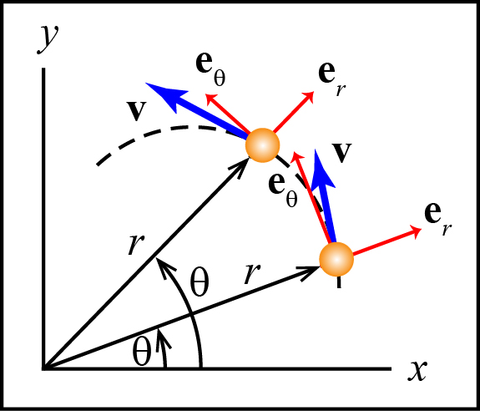
Example 3.4-1
Draw the r-θ axes, and the radial and transverse coordinates for both positions of the particle shown.

Slide 10
Position Velocity Acceleration

Slide 11
Position
Position (r) The vector that starts at the origin of the x-y coor. system and points to the particle.

Slide 12
Velocity
Velocity (v)
r-θ axis are body-fixed.

Slide 13
Acceleration
Acceleration (a)
r-θ axis are body fixed.

Slide 14
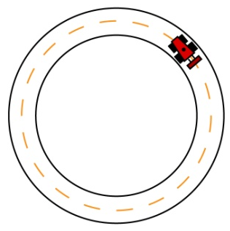
Conceptual Example 3.4-2
For the following situations, write an expression for the velocity and acceleration in polar coordinates.
A car travelling on a circular track.

Slide 15
Conceptual Example 3.4-2
For the following situations, write an expression for the velocity and acceleration in polar coordinates.
A car travelling on a circular track.

Slide 16
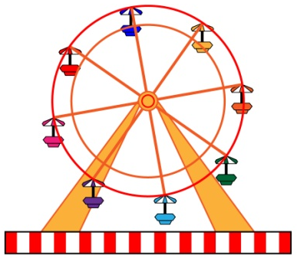
Conceptual Example 3.4-2
For the following situations, write an expression for the velocity and acceleration in polar coordinates.
A car on a Ferris wheel turning at a constant rate.

Slide 17
Conceptual Example 3.4-2
For the following situations, write an expression for the velocity and acceleration in polar coordinates.
A car on a Ferris wheel turning at a constant rate.

Slide 18
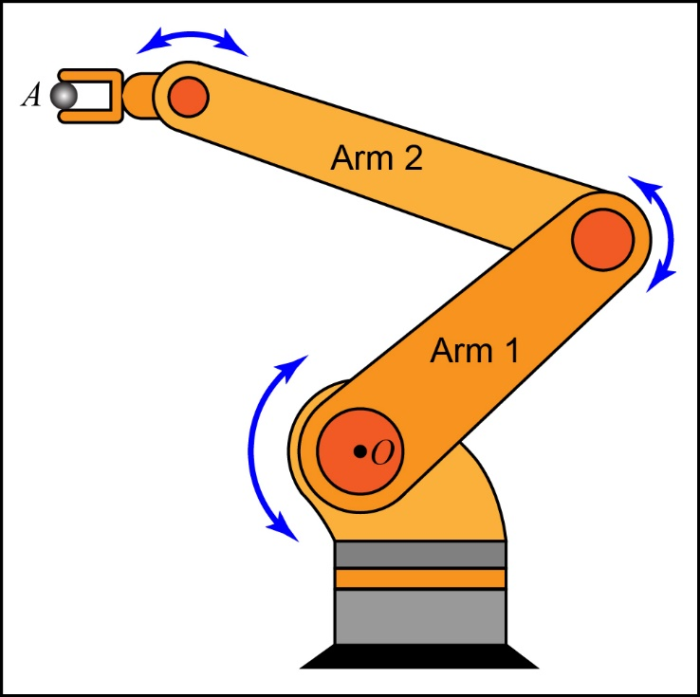
Conceptual Example 3.4-2
For the following situations, write an expression for the velocity and acceleration in polar coordinates.
Body A held by the end of an articulating robotic arm.

Slide 19
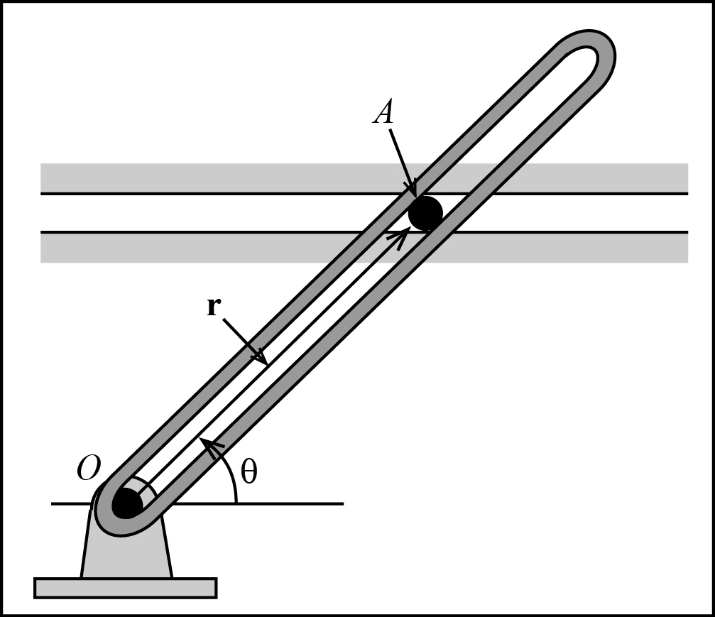
Conceptual Example 3.4-3
If the slotted bar is rotating counter-clockwise at a decreasing rate, what are the signs of the first two time derivatives of θ and the first derivative of r?
Positive?
Negative?

Slide 20
Conceptual Example 3.4-3
If the slotted bar is rotating counter-clockwise at a decreasing rate, what are the signs of the first two time derivatives of θ and the first derivative of r?
Positive?
Negative?

Slide 21
Polar vs. n-t Coordinates

Slide 22
r−θ versus n-t
It is important to note that the r-θ and n-t coordinate systems do not necessarily coincide.

Slide 23
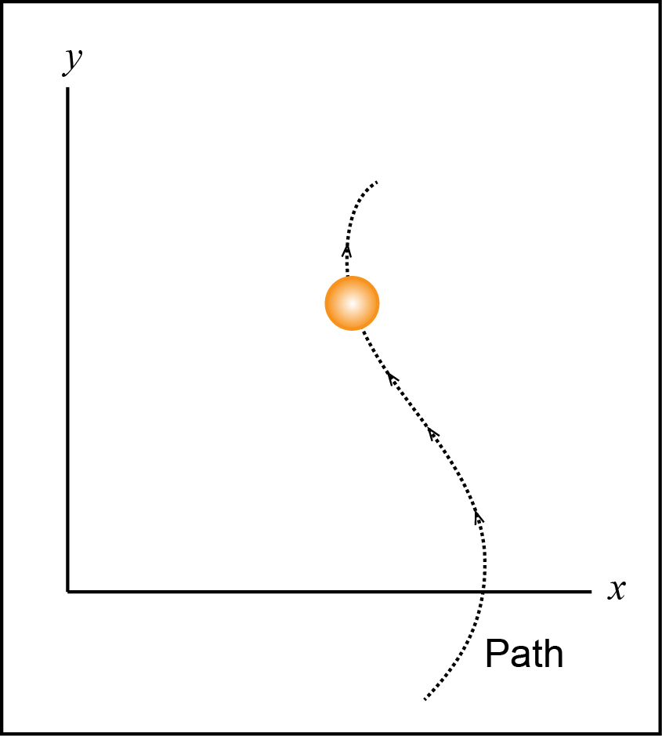
Example 3.4-4
Draw the r-θ and n-t axes.
Include the position and velocity vectors, and the transverse coordinate.

Slide 24
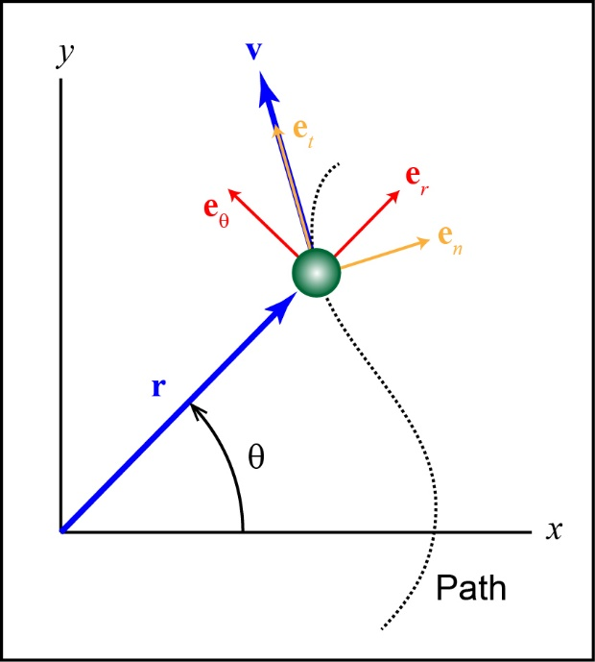
Example 3.4-4
Draw the r-θ and n-t axes.
Include the position and velocity vectors, and the transverse coordinate.

Slide 25
Example 3.4-4
Include the position and velocity vectors, and the transverse coordinate.

Slide 26
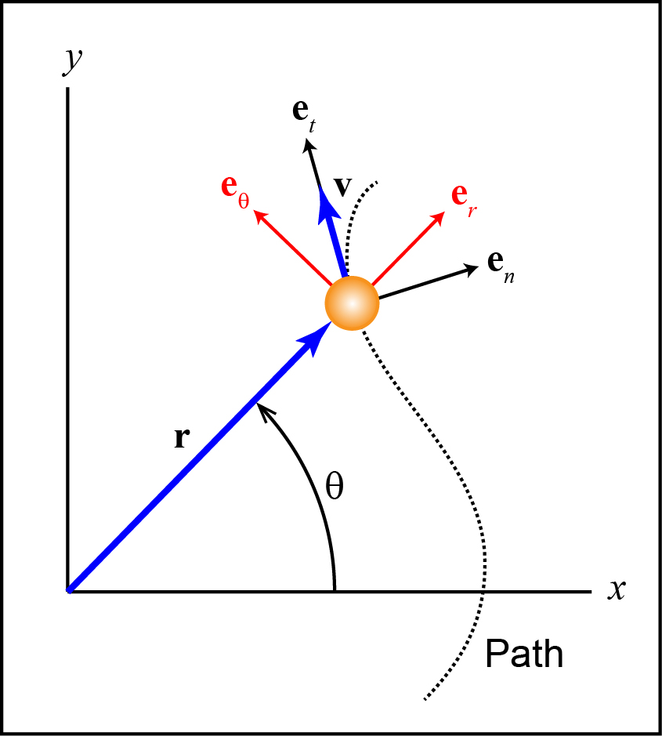
r−θ versus n-t
In the n-t coordinate system, the velocity has only a t component.
In the polar coordinate system, the velocity usually has both an r and θ components.

Slide 27
Important Equations
= ω = Angular velocity (rad/s)
= α = Angular acceleration (rad/s²)

Slide 28
Example Problems
EP3.4-5
EP3.4-6 (Video)

